Slide 1



Mobile-web Solution to connect citizens and local residents with Sanitation agencies
Team members:
Jacob SAWODOGO
Martial Assane PALM
Ousmane SAMBA
Pape Samba DIOP
Mansour FALL
Un sms, un cadre de vie sain!

Slide 2


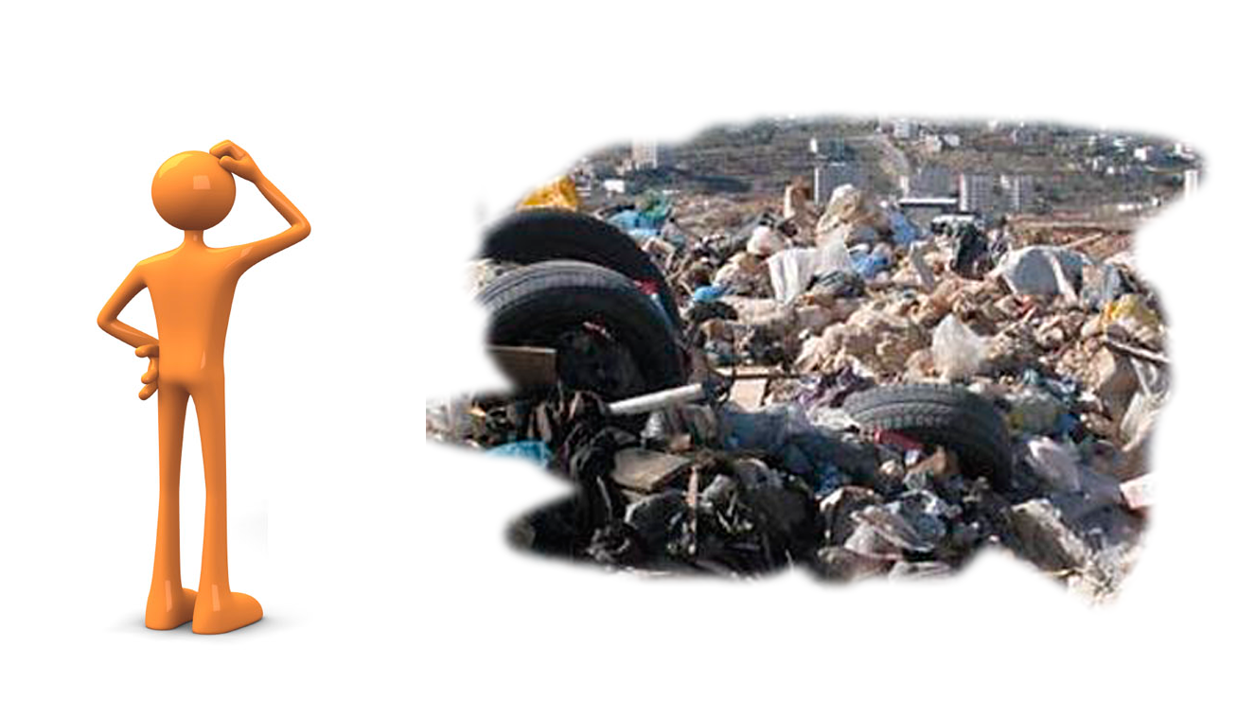
How to involve citizens in sanitation problems resolution ?
How to inform sanitation agencies more efficiently ?

Slide 3







Web
Feature Phone
Platform
IOS Phone
Android Phone

Slide 4

JOB WELL DONE !!!

Slide 5
Démo!!!

